Slide 1
Mobile-Investigator

Slide 2
Introduction
Goal for this challenge is to unravel hidden messages concealed within files. With the knowledge that the file owner uses a single password for most accounts, our objective is to identify a secret message, known as the flag. Focusing on cracking an Android device's password to access and decrypt a database, presumably for forensic or security testing purposes.

Slide 3
Scope
Objective: Enhance forensic analysis techniques to extract hash and salt from Android system files and crack passwords using Hashcat.-
Key Focus: Identify specific files and folders relevant to forensic investigations, such as system databases and configuration files containing hash and salt values.-
Techniques Employed: Use advanced extraction methods to retrieve hash and salt, followed by employing Hashcat for efficient password cracking.-
Expected Outcomes: Achieve higher success rates in accessing secured data on Android devices, improving the thoroughness and accuracy of forensic examinations.

Slide 4
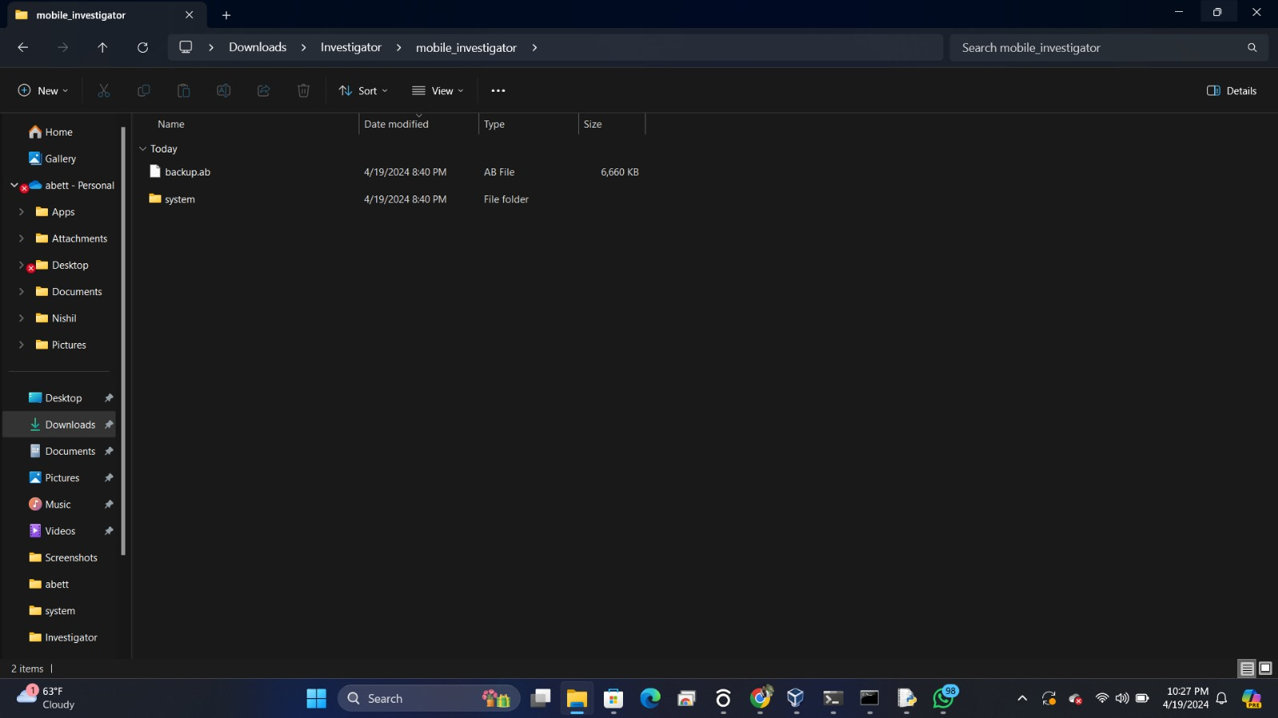
Method
1.Extract the file which contains system folder and backup.db

Slide 5

Method
⁠2.⁠ ⁠Hash Extraction: The password's hash is extracted from a specific file path on a user's system. This hash appears to be a combination of SHA1 and MD5 algorithms. "C:\Users\abett\Downloads\Investigator\mobile_investigator\system\password.key"

Slide 6
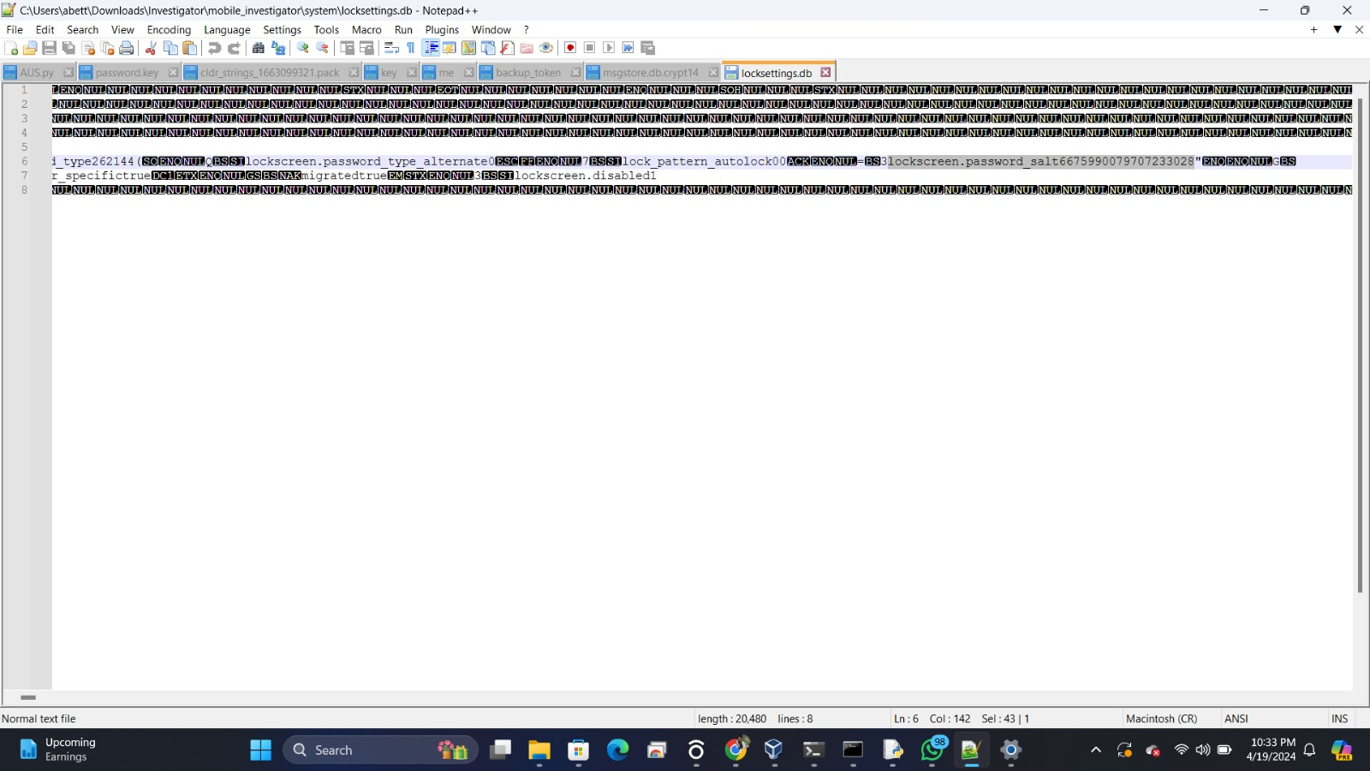
Method
⁠3. Found the salt value which is used in the password hashing process retrieved from a database.(locksettings.db) "C:\Users\abett\Downloads\Investigator\mobile_investigator\system\locksettings.db"
Used sqLite to open the database

Slide 7
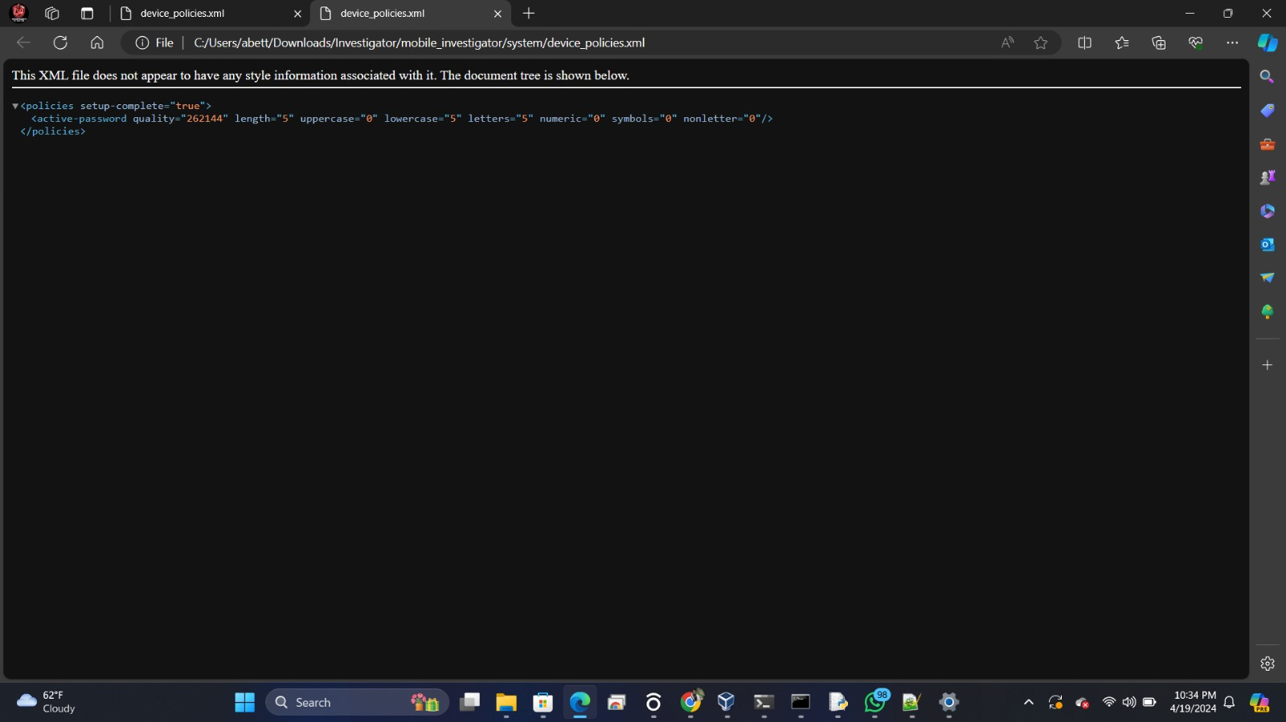
Method
4. Found how password is stored including password quality, length and character composition

Slide 8
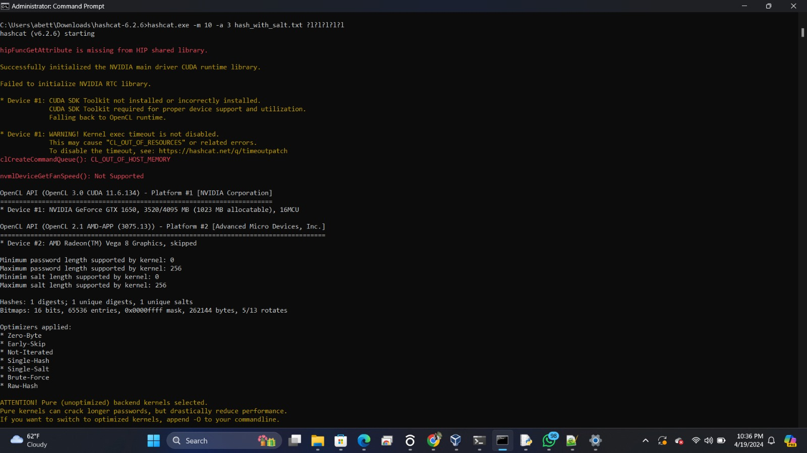
Method
5. Converting the salt value to hex in order to crack the password

Slide 9
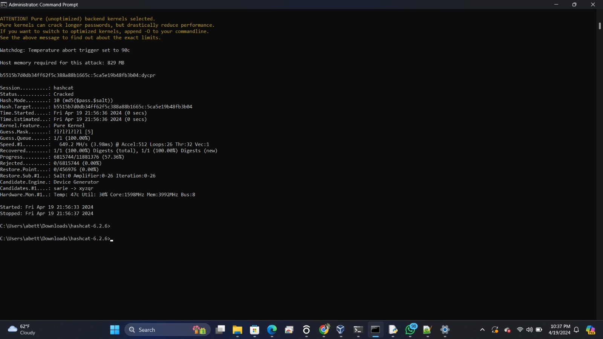
Method
5. Converting the salt value to hex in order to crack the password

Slide 10
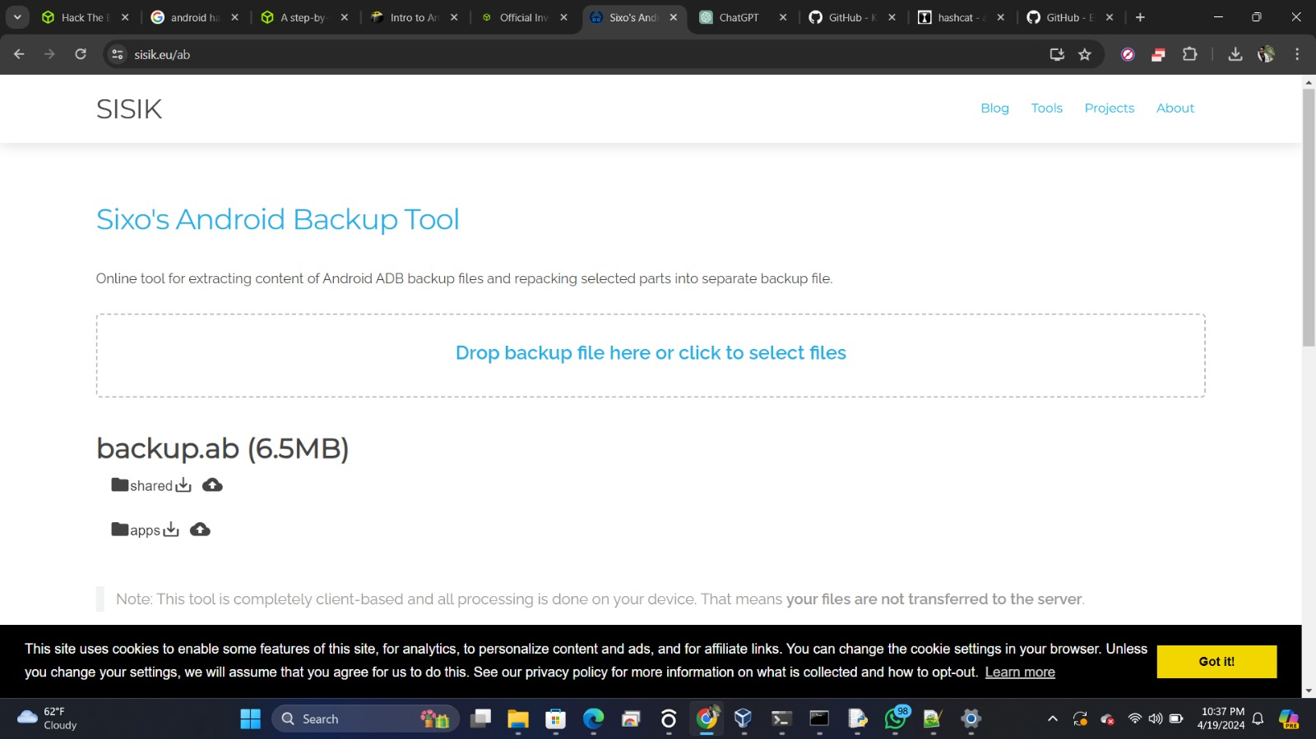
Method
6. Decrypting the database to extract the flag.

Slide 11

Tools
Sixo’s Android backup tool
Sqllite
HashCat

Slide 12
Result
Successfully extracted hash and salt from system files. - Cracked the password using Hashcat, leading to access to backup.ab.
Password: dycpr

Slide 13
Conclusion
For cybersecurity practitioners and learners, this challenge serves as a practical case study on the vulnerabilities of Android password security and offers a real-world example of how to approach similar cybersecurity challenges.Overall, this challenge not only demonstrates the capability to breach Android device security but also emphasizes the continuous need for advancing security measures to counteract such sophisticated cracking techniques.

Slide 14
THANK YOU

